Slide 1
Categorizing YouTube Videos
Nitesh Gupta
Tanmay Gore

Slide 2
Why Cluster Youtube Videos?
Benefits:
Monetary Benefits
Video Recommendation
Why Clustering:
Video Categories might not be known beforehand.
Can consider metadata for classification

Slide 3
TFIDF
Data Set contains following features:
Title
Tags
Description
Converts text to numbers
Prioritizes meaningful information over stop words
Result – 50,000 dimensions

Slide 4
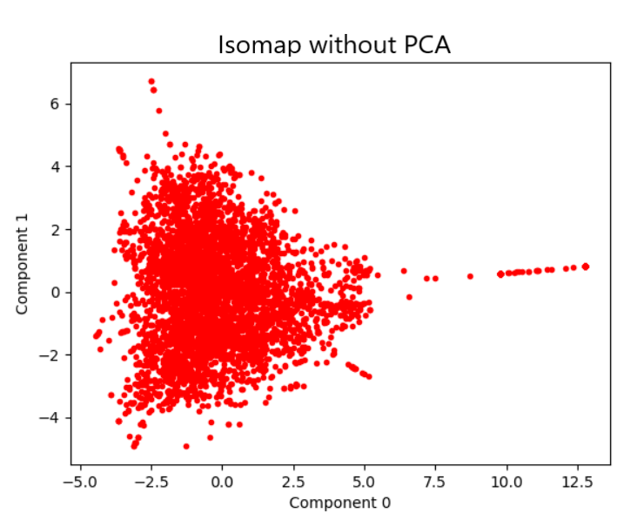
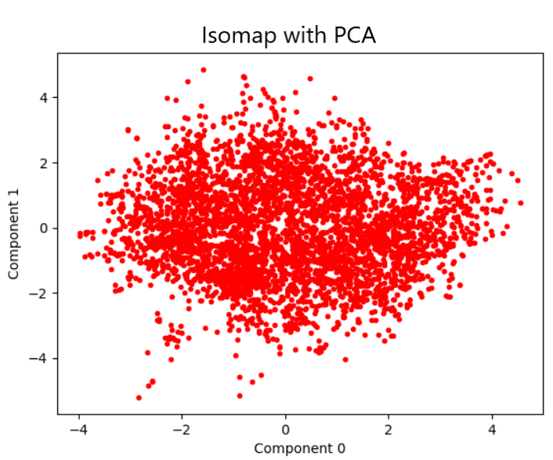
PCA
Dimensionality Reduction
Reduces 50, 000 dimensions to 3000 with only 5% loss of information.

Slide 5
KMeans
Centroid based clustering
Uses Silhouette coefficient to identify correlation between clusters
+1 : best cluster (Clusters are non overlapping)
0 : cluster are overlapping
-1 : worst clusters (data points are assigned to wrong clusters)

Slide 6
Performance Measure
CLUSTERS | SIHOUETTE VALUE | TRAINING TIME (Sec) | CLUSTERS | SILHOUETTE VALUE | TRAINING TIME (Sec)
2 | -0.006 | 26.17 | 14 | 0.017 | 51.75
3 | -0.003 | 28.08 | 15 | 0.015 | 56.36
4 | -0.002 | 28.56 | 16 | 0.016 | 55.47
5 | 0.002 | 31.67 | 17 | 0.019 | 65.68
6 | 0.002 | 35.15 | 18 | 0.020 | 65.99
7 | 0.004 | 36.53 | 19 | 0.021 | 66.00
8 | 0.006 | 37.03 | 20 | 0.022 | 66.40
9 | 0.009 | 42.22 | 21 | 0.024 | 71.24
10 | 0.009 | 45.15 | 22 | 0.024 | 72.98
11 | 0.01 | 42.73 | 23 | 0.029 | 73.82
12 | 0.007 | 46.68 | 24 | 0.027 | 72.95
13 | 0.016 | 50.25 | 25 | 0.031 | 74.10

Slide 7
Agglomerative Hierarchical Clustering (AHC)
WHY Hierarchical Clustering
NUMBER OF CLUSTERS NOT KNOWN BEFOREHAND IN SEVERAL DATA ANALYSIS PROBLEM
TWO TYPES
TOP DOWN : START WITH A ONE LARGE CLUSTER
BOTTOM UP : INITALIZE EACH DATA POINTS AS ITS OWN CLUSTER AND RECURSIVELY MERGE THE CLUSTERS
CLUSTER DISTANCE
SINGLE LINKAGE
COMPLETE LINKAGE
AVERAGE LINKAGE
WARD LINKAGE : minimizes the total within-cluster variance
Notes:
Greedily form data clusters based on local correlations between the data points.
At each step find the pair of clusters that leads to minimum increase in total within-cluster variance after merging.

Slide 8
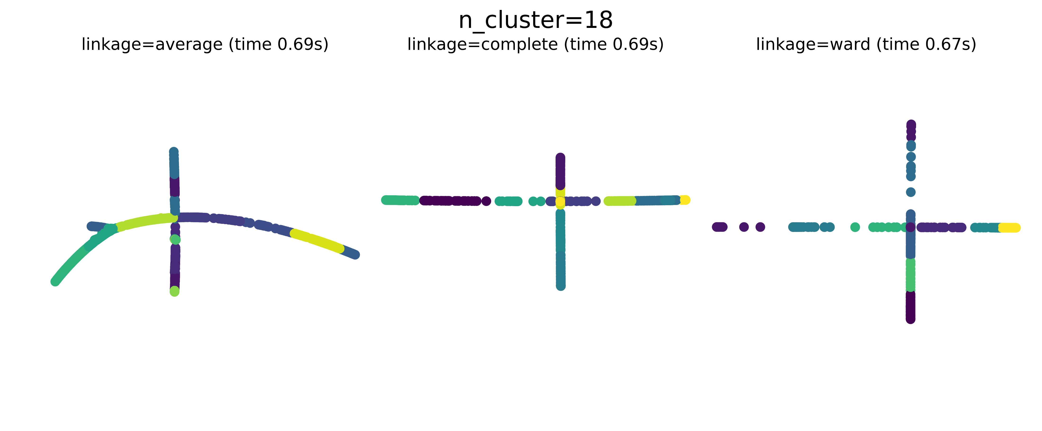
RESULTS
AHC

Slide 9
REFERENCES
CONCLUSION
Agglomerative Hierarchical Clustering
Clusters: 18, linkage : ward, Silhouette Coefficient: 0.023, Training time: 0.67 s
KMEANS clustering
Clusters: 18, N_ITER : 20, Silhouette Coefficient: 0.020, Training time: 65.19 s
LECTURES SLIDES BY DR. CHINMAY HEGDE FOR EE 525X SPRING 2018, ISU
https://en.wikipedia.org/wiki/Isomap
https://stats.stackexchange.com/questions/124534/how-to-understand-nonlinear-as-in-nonlinear-dimensionality-reduction
https://en.wikipedia.org/wiki/Hierarchical_clustering

